Slide 2
DNA extraction
04

Slide 3
Teacher notes: Session contents
Collecting samples | 10 min | Check that samples are photographed and collection information recorded prior to starting.
Following a laboratory procedure | 10 min | A brief introduction to the skills needed to follow a laboratory procedure effectively. Support reading through the procedure highlighting important points.
Extracting DNA | 40 min | Following the laboratory procedure for DNA extraction using a simple alkaline lysis method

Slide 4
DNA extraction
Collecting samples
Following a lab procedure
Extracting
DNA

Slide 5

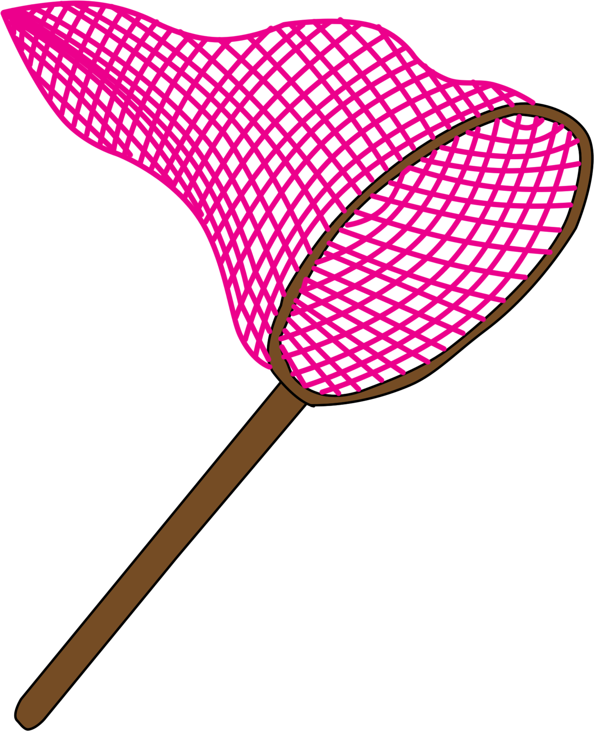
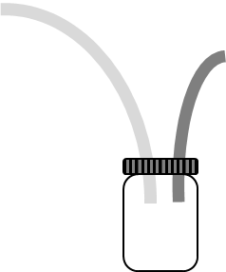
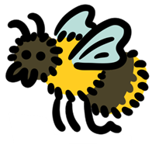
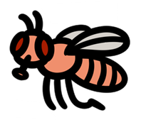
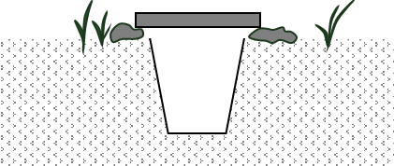
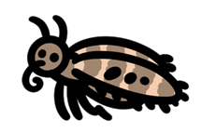
Collecting samples
You should have collected an invertebrate to use in your project.
The sample needs to be fresh (not more than 2 days old)
Choose and use an appropriate method to collect your invertebrate
Place your sample in a Ziplock bag
Label the bag with your initials
Place the Ziplock bag in a -20°C freezer

Slide 6
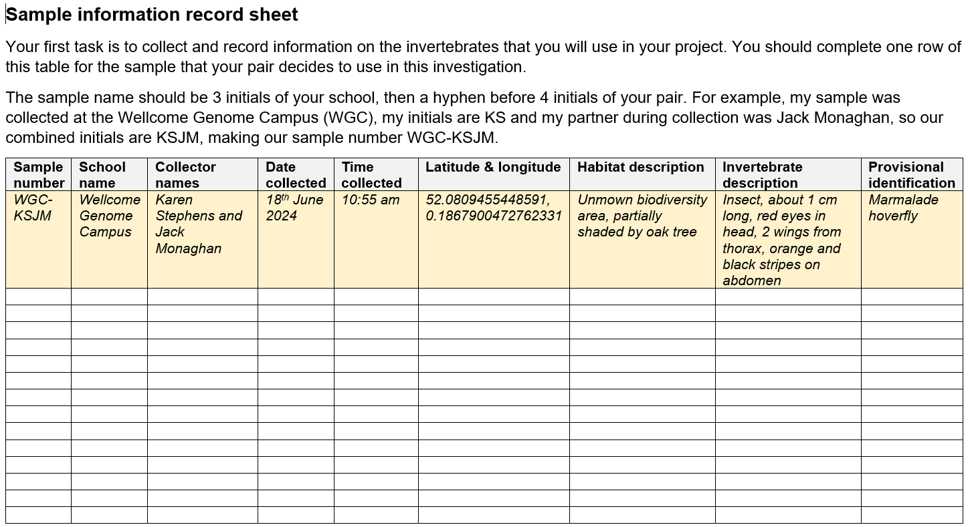
Collecting samples
As well as collecting an invertebrate, you should have recorded information on the specimen that you will use, so another scientist could check the reproducibility of your results.
Take a photo of your invertebrate sample
Find the sample information record sheet in a file named ’02_R_Sample-information-record-sheet’
Complete the sample information record sheet (using the example to help you)

Notes:
Notes:
Store the photo of your invertebrate somewhere you will be able to find it again!
Please use the standardised method of naming samples and ensure that there aren’t 2 samples with the same sample name
Google Maps will give co-ordinates for a location, as will any device with GPS
The Field Study Council guides are helpful in preliminary identification of invertebrates

Slide 7
DNA extraction
Collecting samples
Following a lab procedure
Extracting
DNA

Slide 8
Following a lab procedure

The scientific method is a way of researching new areas. It follows set stages to help structure new scientific research.
Observation
?
Question

Hypothesis

Experiment

Analysis

Conclusion

Slide 9
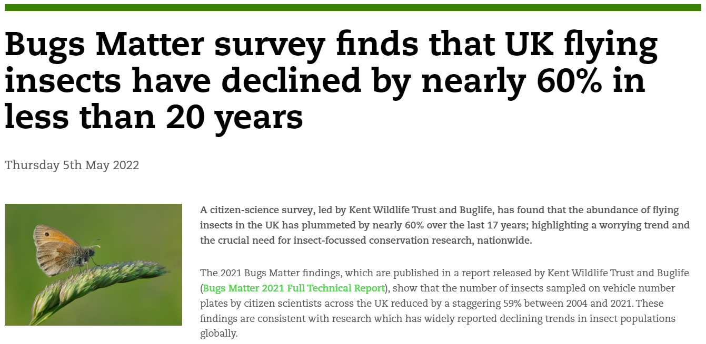
Notes:
Observation: It is widely accepted that the number of insects is declining.

Slide 10
Following a lab procedure

Observation
Observation: Invertebrate numbers are declining and we don’t know what invertebrates are present in our school environment.
Question: What invertebrates are present in our school environment? n
Hypothesis: We can identify the invertebrates present in our school environment using DNA barcoding.
Experiment: We will identify the invertebrates present in our school environment by following a laboratory procedure for DNA barcoding.
Analysis: Accuracy of DNA sequence will be analysed and known invertebrates identified by comparison to a database.
Conclusion: This will allow us to conclude what invertebrates are present in our school environment and make suggestions for future work.
?
Question

Hypothesis

Experiment

Analysis

Conclusion
Notes:
Fitting Barcoding for beginners to the scientific method

Slide 11
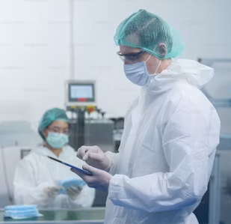
Following a lab procedure
For the experimental stage we will be following a laboratory procedure for DNA barcoding.
Being able to follow a laboratory procedure is important, because:
It will provide Health and Safety information to keep you safe
It draws on previous work, bringing together techniques likely to give success
It means other scientists could replicate your work for comparison of results

Slide 12
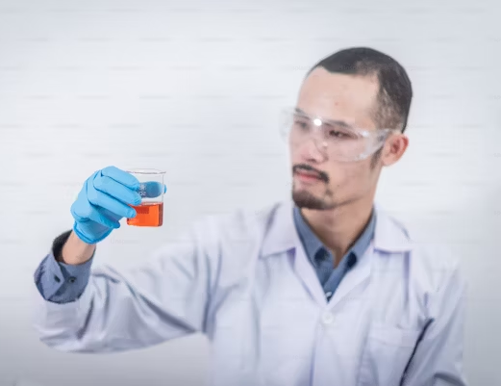
Following a lab procedure
1. Health and Safety information to keep you safe is highlighted in the laboratory procedures.
Information is given in the Health and safety section within the student notes
Where PPE (Personal Protective Equipment) is needed, this is written in the instructions
Notes:
PPE used will include goggles and safety glasses
You can talk about how risk assessments have been completed too if you like
ADD: For example, in the DNA extraction, you are not using anything classed as hazardous, but should wear gloves to avoid contaminating the sample with your DNA.

Slide 13

Following a lab procedure
2. Where important points for success have been found in previous work, these are included in the laboratory procedure.
Information critical for success is included in the laboratory procedure as a ‘TOP TIP’
Notes:
ADD: For example, in the DNA extraction, TOP TIPS include:
Using a small amount of sample
Thoroughly grinding the tissue
Making sure Chelex is not transferred after centrifugation

Slide 14
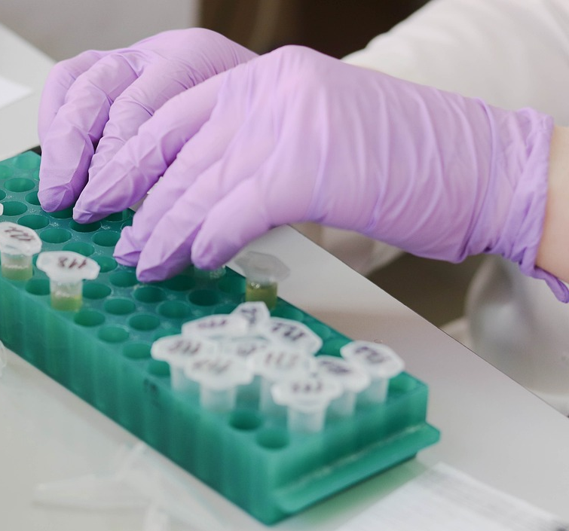
Following a lab procedure
3. It is important that you, or another scientist, could replicate your work, so that results can be verified.
Repeatability is the precision obtained when measurement results are produced over a short timescale by one person (or the same group) using the same equipment in the same place.
Reproducibility is the precision obtained when measurement results are produced over a wider timescale by different people using equivalent equipment in different (but equivalent) places.
Following a set laboratory procedure should allow repeatability and reproducibility.
Notes:
ADD:
For example, in the DNA extraction, the volumes, reagents, timings, temperature of incubation and speed of centrifugation are specified to increase precision.

Slide 15
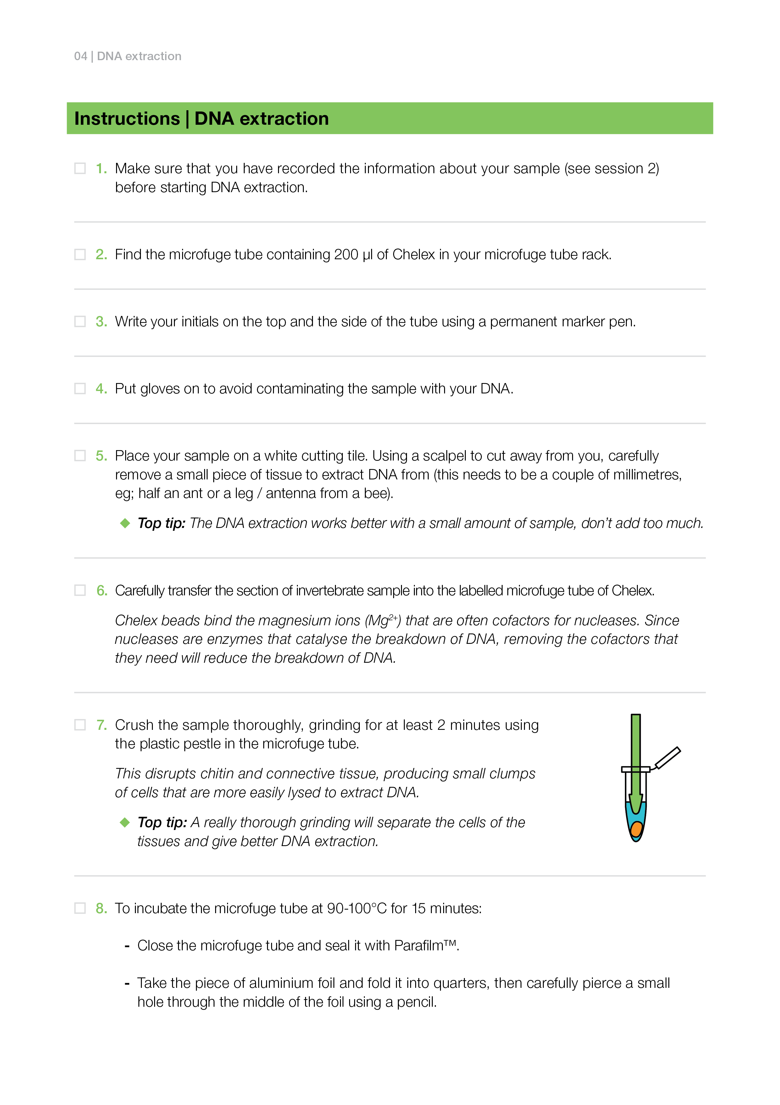
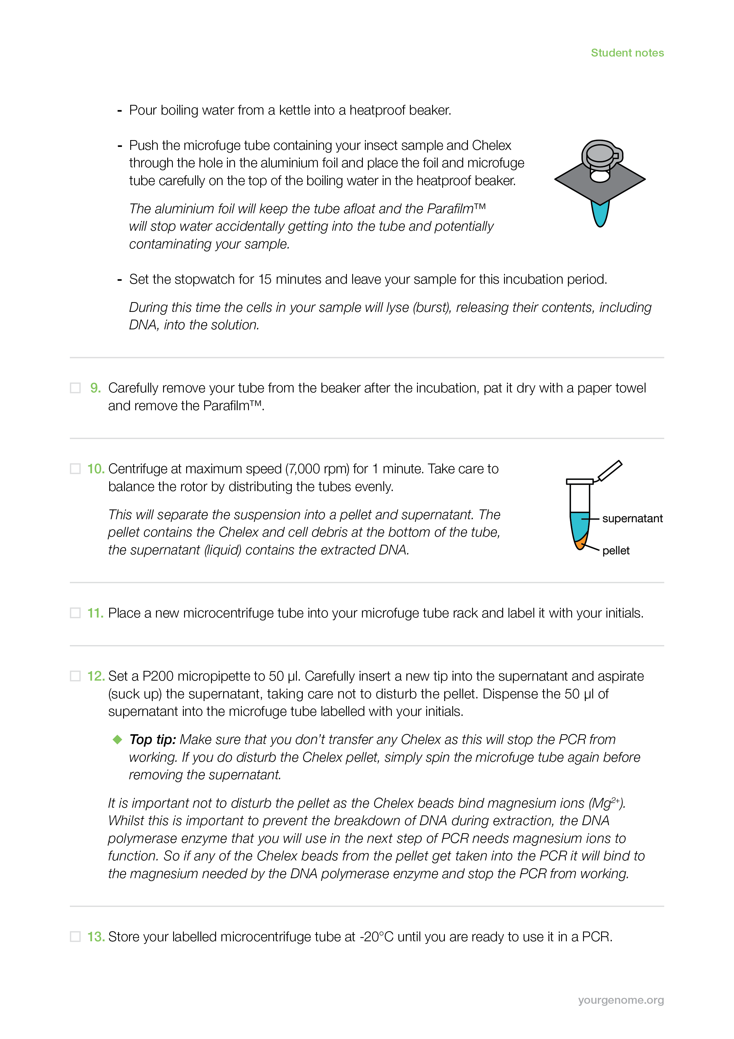
Following a lab procedure
To get the benefits of the laboratory procedure, you should:
Read the laboratory procedure before starting.
Check you understand what you need to do.
Ask questions about anything that you don’t understand.
Work through the steps carefully. (You can tick them off as you go using non-permanent marker. Please don’t use the Sharpies!)

Slide 16
DNA extraction
Collecting samples
Following a lab procedure
Extracting
DNA

Slide 17
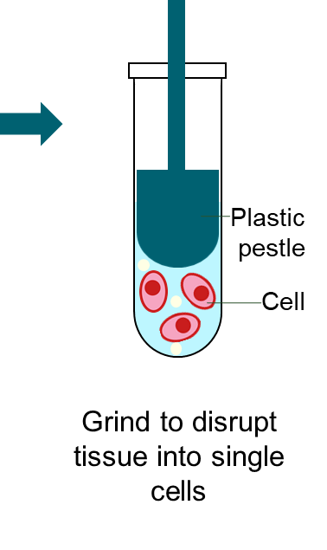
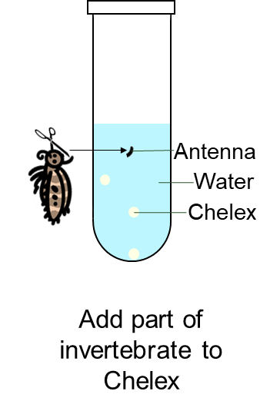
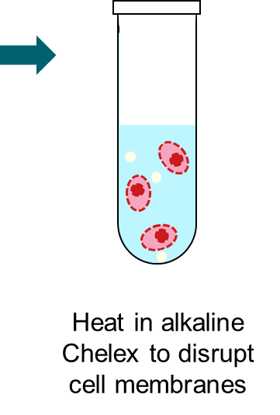
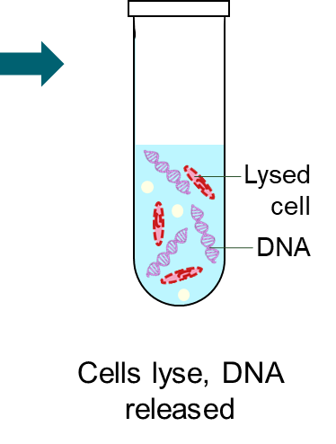
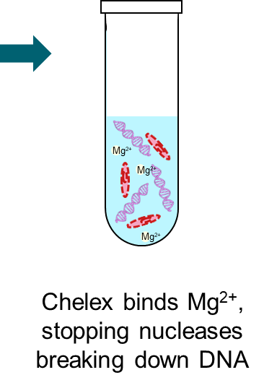
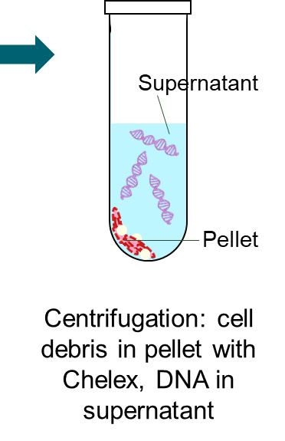
Extracting DNA
An overview of the stages of DNA extraction from an invertebrate sample:

Slide 18
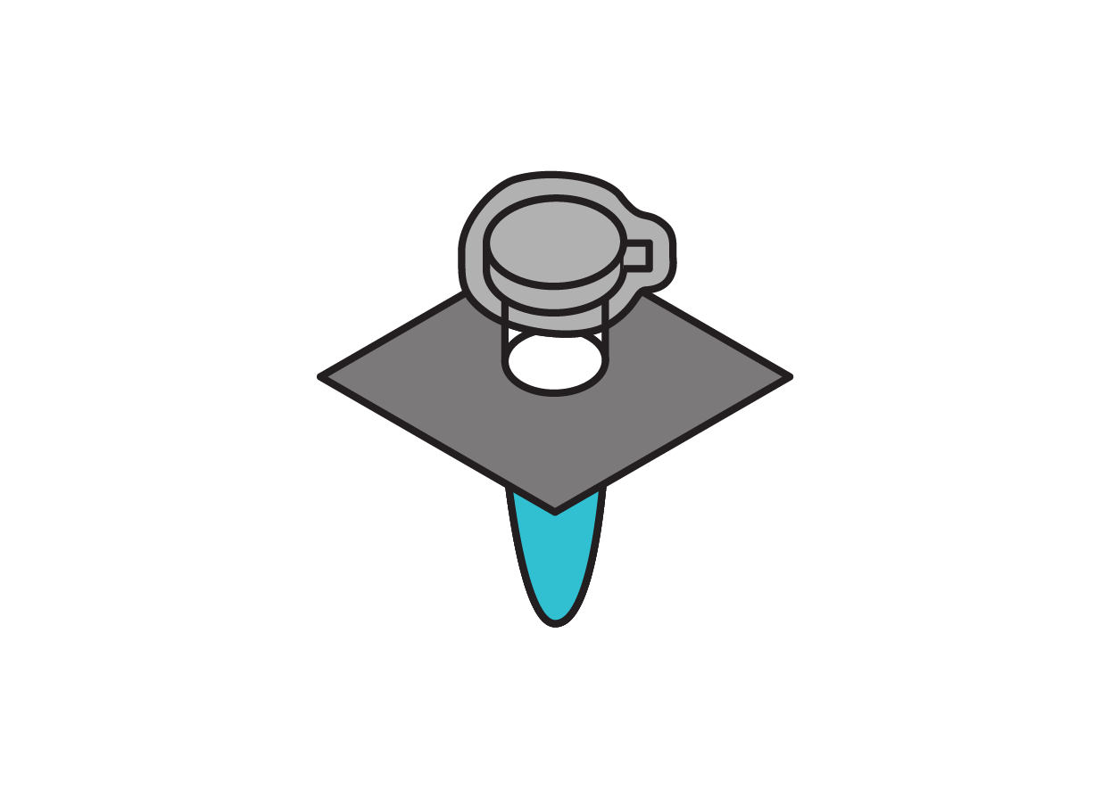
Extracting DNA
To avoid getting water in the microfuge tube when heating:
Close the lid firmly
Stretch waterproof Parafilm around the top
Balance through 4 layers of aluminium foil to keep the sample in the water and the lid out of the water
Stand up and take care when working with very hot water.

Slide 19
Extracting DNA
Centrifugation spins the samples at a high speed (7,000 revolutions per minute / rpm).
If the rotor is unbalanced when spinning this fast, it will become misshapen.
Make sure that the rotor is balanced before starting centrifugation

Slide 20

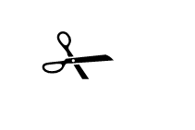

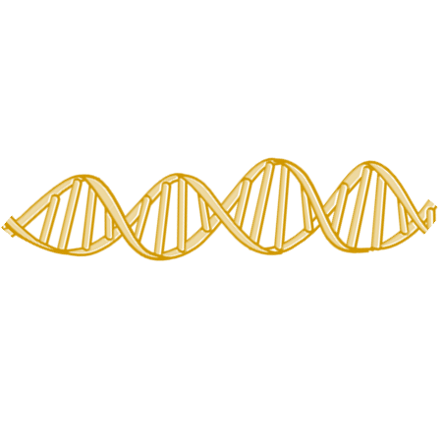
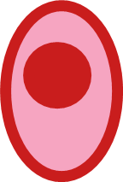

Extracting DNA
TOP TIPS
Use a small amount of sample | Thoroughly grind the tissue | Make sure Chelex is not transferred after centrifugation
Supernatant
Antenna
Plastic pestle
Water
Chelex
Cell
Pellet

Slide 21
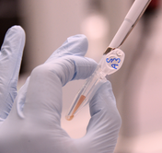
Extracting DNA
Health and Safety
No chemical substances are classed as hazardous
Wear gloves to avoid contaminating the sample with your DNA
Stand up and take care when working with hot water to avoid scalding / burns

Slide 22
DNA extraction
Collecting samples
Following a lab procedure
Extracting
DNA
Next session we be amplifying the DNA barcode from our DNA sample using PCR.

Slide 23
Thank you
Barcoding for beginners is a project by Wellcome Connecting Science, funded by a Royal Society Partnership grant.
All resources can be found on YourGenome: yourgenome.org/theme/barcoding-for-beginners
Image credits Wellcome Connecting Science Insect illustrations: Petra Korlević

